Slide 1
Scalable Data Analytics
SENG 550
AKA. Big Data - Data Engineering
Armin Zirak

Slide 2
Distributed Databases
5

Slide 3
Distributed Data
Traditionally, one method to scale a system (e.g., when the user requests exceed 100 per second) was to upgrade to a larger machine.
For instance, a machine with 10 GB of RAM could be replaced with one that has 30 GB.
This was known as Vertical Scaling.
However, this approach didn’t last long:
Cost: Increasing hardware resources is expensive.
Doubling the RAM could significantly raise the overall cost.
Single Point of Failure: If the machine fails, the entire system fails
E.g., due to a power outage at the data center
It’s not possible to scale up a single machine beyond a point.

Slide 4
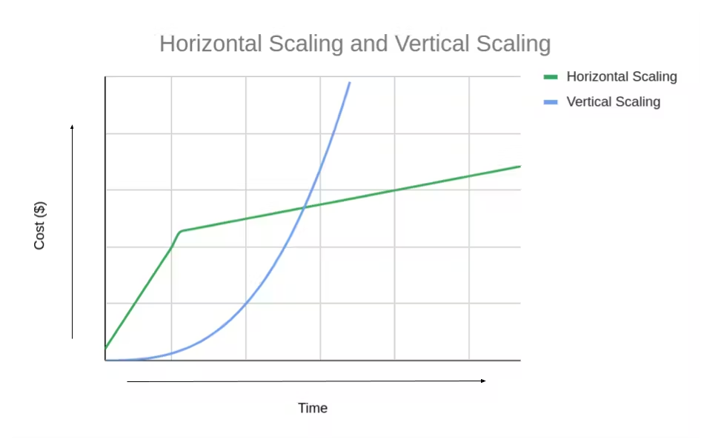
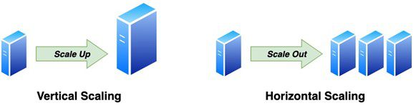
Horizontal Scaling
Horizontal Scaling: Instead of upgrading a single, larger machine, the workload is distributed across multiple smaller machines (nodes).
Fault Tolerance: If one node fails, the others can continue to serve users, ensuring higher availability.
Cost Efficiency: Purchasing 10 machines with 10 GB of RAM each is often more cost-effective than buying a single machine with 100 GB of RAM
Scalability: Horizontal scaling allows systems to grow incrementally, enabling the addition of more machines as needed, without hitting hardware limits as quickly as with vertical scaling.

Slide 5
Horizontal Scaling
Distributing data, such as a large "orders" table, across multiple machines is complex.
This process involves two primary strategies:
Replication: Copies of the same data are stored on multiple machines.
Partitioning (Sharding): The data is divided into smaller, independent chunks.

Slide 6
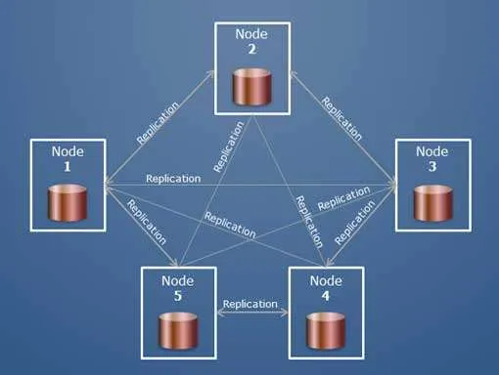
Replication
Let's assume the database is small enough for each machine to store the entire dataset. The challenge then becomes distributing the query workload.
For example, there is 1 TB of data that can fit on each system, but there are 1,000 requests per second, while each computer can handle only 300 requests per second.
In this case, we need to distribute the incoming queries across multiple machines to handle the load efficiently.

Slide 7
Replication
The workload is distributed. Each node needs fewer resources.
If one node goes down or gets disconnected, the others can continue serving users with minimal manual intervention.
By distributing nodes across different regions, users can access the closest database. This reduces latency.

Slide 8
Replication
The real challenge is when a user makes an update.
How do we replicate it across all databases?

Slide 9
Replication
There are three types of replication based on how writes are handled:
Single-Leader: One node handles all writes
Multi-Leader: Multiple nodes can accept writes.
Leaderless: Any node can handle writes, requiring conflict resolution later.

Slide 10
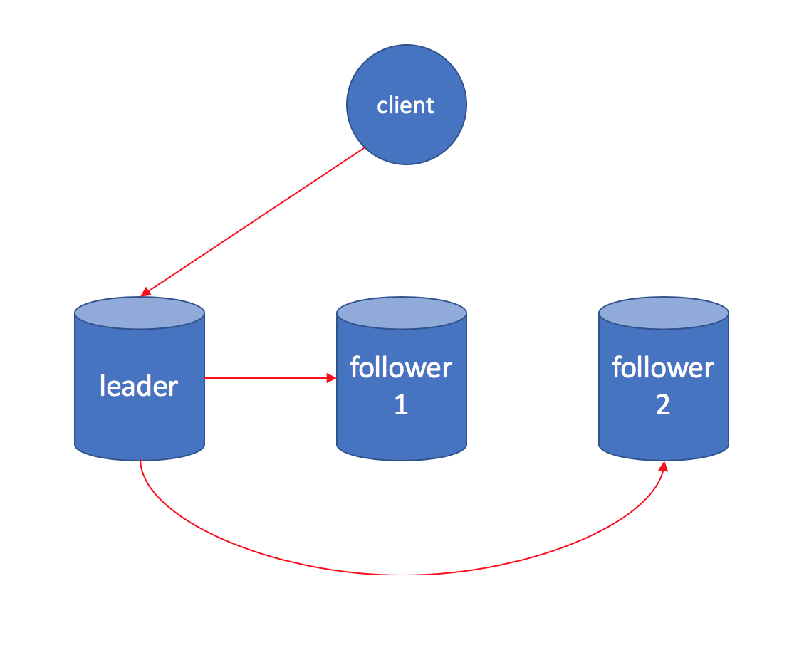
Single Leader (Leader Follower)
In this architecture, one node acts as the leader while the others are followers.
The leader receives updates and sends them to the followers.
Read queries can go to either the leader or the followers.
There may be a data lag between the leader and followers.

Slide 11
Single Leader (Leader Follower)
While read queries are distributed, write queries must be applied to every node.
Read frequency is often multiple times higher than writes.
Many relational and non-relational databases have implemented this feature internally. This allows the software (or DevOps) engineers to configure them while the complexities are abstracted.
PostgreSQL
MySQL
MongoDB
Redis

Slide 12
Single Leader (Leader Follower)
Important question: Once the leader receives the update and applies it, can it send an “ok” to the client?
Or, does it have to wait for all the nodes to apply the change before sending the “ok”?

Slide 13
Single Leader (Leader Follower)
Asynchronous replication: The leader confirms to the client that the update is applied while followers asynchronously apply the update.
Synchronous replication: Leader waits for all the updates and then sends confirmation to the client.

Slide 14
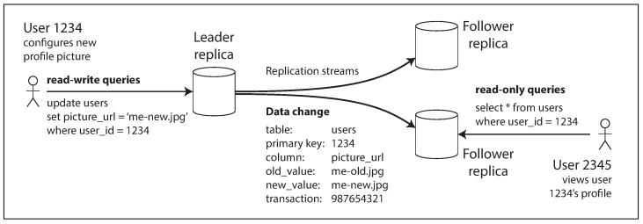
Single Leader (Leader Follower)
There can be a data lag between the leader and its followers until data is replicated.
This lag is typically within seconds but can be longer (e.g., if a client is disconnected from the leader or if the follower has insufficient processing ability and falls behind).
The image below illustrates how this lag can result in clients seeing different results when querying different nodes.
While synchronous replication makes sure that the data is replicated in all nodes, asynchronous prefers faster response at the cost of possible inconsistencies.

Slide 15
Single Leader (Leader Follower)
Synchronous Replication Issues: If one replica is disconnected from the cluster, the leader cannot confirm the write.
This results in the request failing even if only one node is down (Single Point of Failure).
Each node can become a bottleneck.
Asynchronous Replication Issues: Data will have eventual consistency.
If a replica is disconnected or falling behind, the users reading from that node see inconsistent data.
Durability is not guaranteed. If the leader breaks, the latest writes are lost.

Slide 16
Leader Failover
If the leader fails in a single-leader setup, there are a few approaches to handle this.
Standby Leader: One node plays the standby leader. If the primary leader fails, the standby node replaces it.
Leader Election: The cluster elects a new leader that comes up to accept the new writes.
Multiple Leader Solutions: (Next Slide)

Slide 17
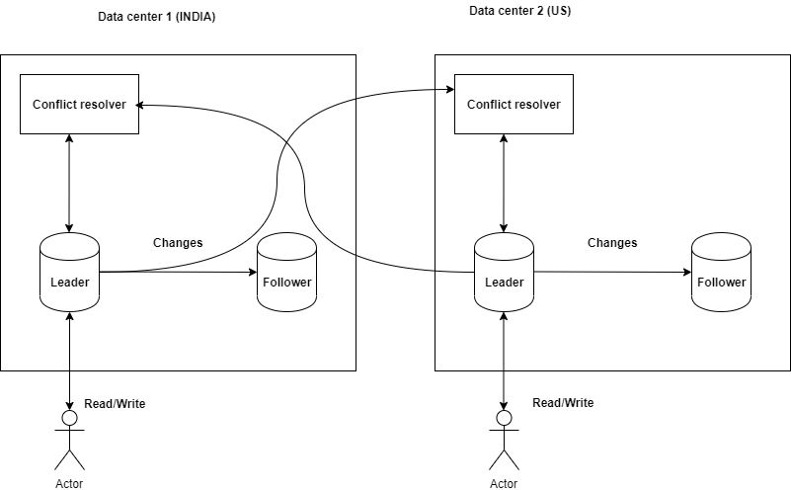
Multi-Leader Replication
Multiple leaders can accept writes simultaneously.
A single leader is no longer a single point of failure.
The write workload would be distributed between the nodes.
The write latency could be lower.

Slide 18
Multi-Leader Replication
Concurrent updates are the biggest disadvantage.
If the same data is updated by multiple leaders, resolving the conflict is quite complex.
Normally, the DB overwrites the latest update to each node but it still damages the consistency.
(Optional) Refer to this document on how concurrent writes are handled.
https://www.linkedin.com/pulse/distributed-systems-multi-leader-replication-divagar-carlmarx/

Slide 19
Leaderless Replication
Every node can receive the writes.
The write workload is highly distributed
Availability is higher even if a subset of nodes become disconnected.
Handling multiple writes and their conflicts is more complex.

Slide 20
CAP Theorem
CAP Theorem: In a distributed system, you can only get two out of three goals at the same time.
Consistency (C): Consistency means that all clients see the same data at the same time, no matter which node they connect to.
Every read gets the most recent write.
Availability (A): Any client making a request for data gets a response, even if one or more nodes are down.
Partition Tolerance(P): Means that the cluster must continue to work even if the connections between nodes are broken.
When there's a network problem, you have to choose between being consistent (all nodes show the same data) or being available (responding to requests).
For example, synchronous updates give higher consistency while asynchronous updates give higher availability.

Slide 21
Multiple Reads
In the basic scenario, each read request gets data from a single node.
In a more flexible design, the client can read from multiple nodes and pick the latest data.
This increases the chances of read queries being consistent.
In the below example, if the client reads from two nodes, the chances are higher that it gets the most up to date data.

Slide 22
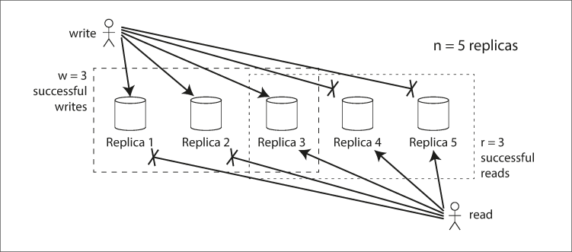
Multiple Writes
Similarly, writes can be sent to multiple nodes before an acknowledgment is received.
For instance, in a synchronous update, writes are sent to all nodes
W is the number of write nodes (write quorum), and R is the number of read nodes (read quorum)
Synchronous updates with standard reads in a leader-follower structure are W=N, R=1.

Slide 23
Quorum Theory
Quorum Theory: A distributed system is consistent if R + W > N.
This ensures that at least one read node has the most up-to-date data.
W and R can be adjusted based on workload.
If writes are infrequent, W can be set to N, but this reduces write availability.
A common approach is to set both to N / 2 (upper bound),
This approach offers a good availability.
If W < N, the cluster can still accept writes if a node is down.
if R < N, it can respond to reads.
Quorum-based systems balance the CAP theorem by letting users trade off between consistency and availability while ensuring partition tolerance.
High Availability
Strong Consistency

Slide 24


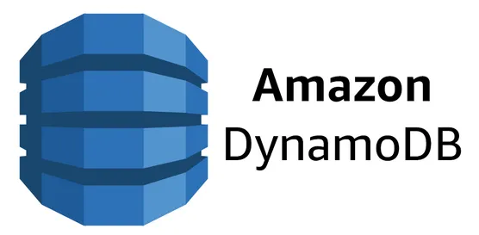
Quorum Theory
Amazon Dynamodb, Cassandra, HBase are examples that use quorum based approaches.

Slide 26
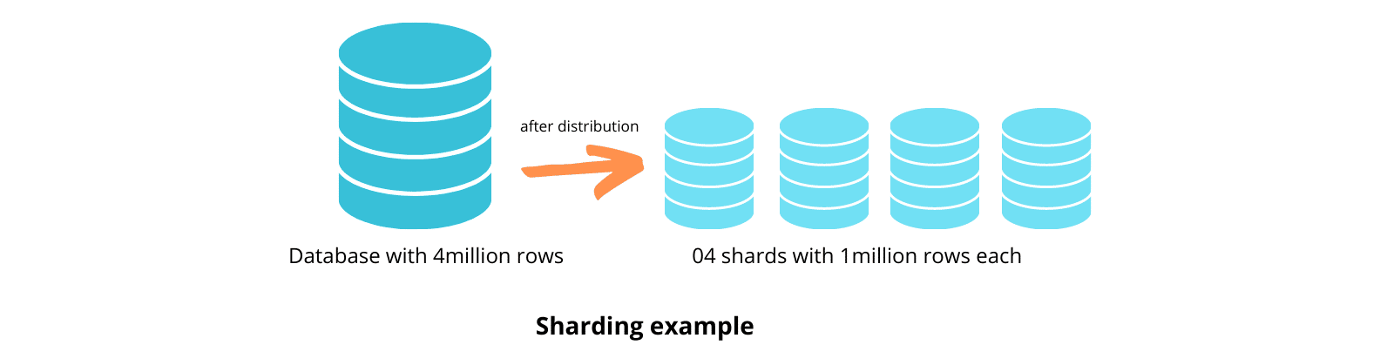
Partitioning (Data Sharding)
When datasets are too large to fit on a single machine, both data and processing are distributed across multiple nodes.
For example, a 10 TB dataset could be split across 10 nodes, each holding 1 TB.

Slide 27
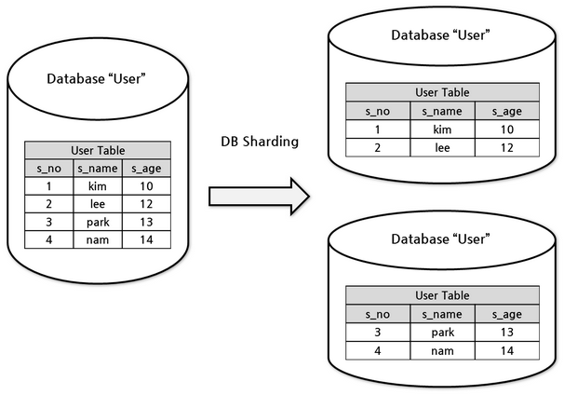
Partitioning (Data Sharding)
The data must be separable for this distribution to work.
In a LinkedIn-like scenario using MongoDB, where each request retrieves one user's profile, users can be split across different nodes.
Similarly, an orders database could partition orders by city, such as having one shard for Calgary orders.

Slide 28
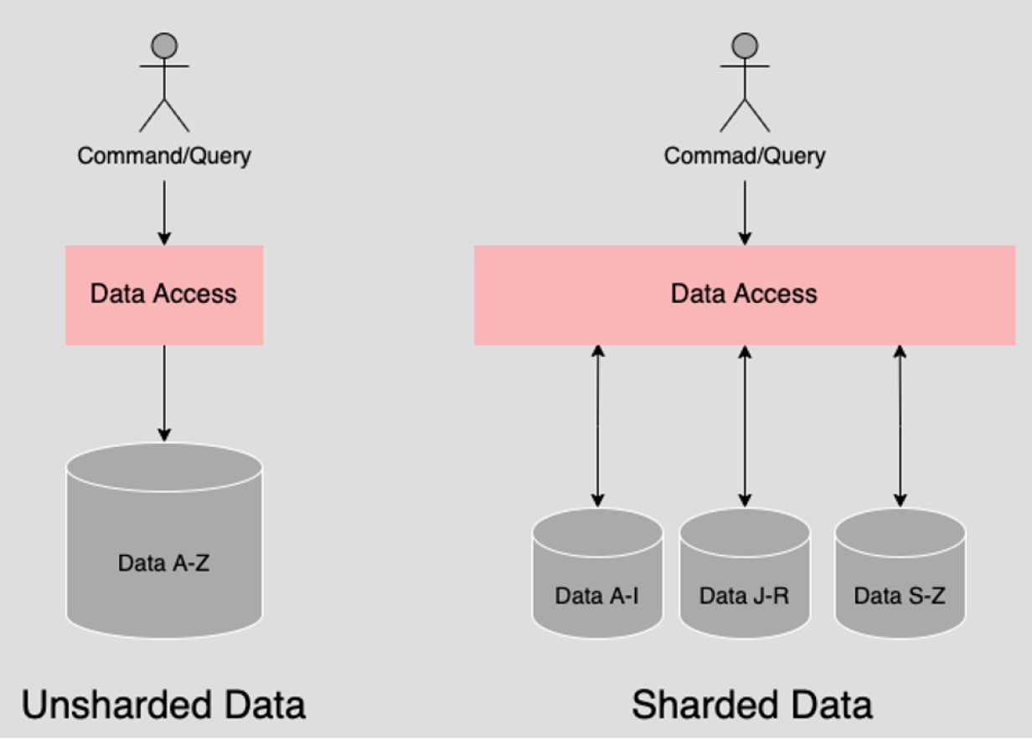
Partitioning (Data Sharding)
Data sharding increases scalability by distributing writes, reads, and data across nodes.
The nodes share almost nothing, making the system more efficient and scalable.

Slide 29
Partitioning (Data Sharding)
In relational databases, where tables can be joined in complex ways, implementing partitioning is more challenging. However, NoSQL databases have paved the way for effective partitioning solutions.
MongoDB, BigTable, Cassandra, and Elasticsearch.
Hadoop-based data warehouses also adopt this concept (will be covered later)
Partitioning and replication can be applied independently
a database can be partitioned first and then replicated across each node.
Relational databases also implement partitioning
They face more limitations since inter-partition joins or aggregations are difficult to execute.
For instance, if orders are partitioned by city, executing a query like SELECT SUM(amount) FROM orders; would require accessing multiple databases and aggregating the results in a separate system.

Slide 30
How to partition data?
How do you decide which records to store on which nodes?
Random partitioning: Randomly assign each record to a node.
When a read query comes in, how do you know which node holds the data?
A sharding algorithm is needed to distribute records evenly across nodes (shards).

Slide 31
How to partition data?
NoSQL databases are typically accessed using a primary key, such as:
(MongoDB) db.users.find({ user_id: 10 })
This primary key is often used for sharding.
For example, shard_id = first digit of user_id
user_id | shard_id
13212 | 1
42123 | 4
23412 | 2
12314 | 1
32132 | 3

Slide 32
Data Skewness
Partitioning should be fair to prevent data skew.
If 9 out of 10 nodes are idle while one node handles most of the data and workload, it defeats the purpose of sharding.
This overloaded node is known as a hotspot.
For example, if user IDs are incremental, and there are 250 users, most user IDs will start with 1 or 2…
Shard 1 (Hot Spot)
Shard 2 (Hot Spot)
Shard 3
Shard 4
Shard 5
Shard 6
Shard 7

Slide 33
How to partition data?
Imagine that distribution is done based on the last digit of user IDs
If the number of shards is not 10, you can use a formula like user_id % number_of_shards However, there is still a possibility that data may not be evenly distributed this way.
For example, if the process that generates IDs is not truly random.
user_id | shard_id
13212 | 2
42123 | 3
23412 | 2
12314 | 4
32132 | 2

Slide 34
Key Range
Sometimes, primary keys may are not numeric
String: email addresses
Timestamp
Key Range is a possible solution for partitioning, where data is divided into ranges.
For example, Partition 1 could handle keys from A to M, while Partition 2 could cover N to Q, etc
With key ranges, some shards can still become hotspots.
For instance, with timestamps, most queries are likely to access the shards containing the most recent data.
As an example, if you have 12 shards, one for each month of the year, queries would consistently target the shard corresponding to the current month, leading to uneven load distribution.

Slide 35
Hash Key
Hash-based partitioning: A hash key is often used as an alternative solution to achieve balanced partitions:
shard_id = hash_function(primary_key) % number_of_shards.
This method helps evenly distribute records across shards, minimizing hotspots.
Downside: Using a hash function can lead to a scenario where adjacent IDs are no longer stored as adjacent rows in the database.
For instance, if you are retrieving rows based on adjacent timestamps, you may hit different shards.

Slide 36
Shard Changes
Data needs to be rebalanced when the number of shards changes
Depending on the workload, we may need to add a new shard to handle higher traffic or remove one to reduce the costs.
For example, when adding a new shard, some of the current data needs to be moved to it.
Also, some data in existing shards may need to move depending on the sharding strategy (e.g., shard_id = id % number_of_shards).
When removing a shards, same complexities apply.
Rebalancing strategies should ensure that the cluster works during the changes.

Slide 37
Summary
Choosing the sharding strategy is up to software engineers and data developers.
They sharding algorithm needs to:
Evenly distribute the data across shards to prevent hotspots and ensure balanced load.
Ensure that the result of each query is stored within a single shard so there is less need for cross-shard queries.

Slide 38
Sharding Example: Restaurant Management System
Imagine a restaurant management system that waiters use to handle orders and receive payments.
This system includes a dashboard for restaurant management to view data analytics reports such as
the number of orders received by each waiter
the total revenue generated by each menu item.
The data analytics queries in this case always use one restaurant's data
e.g., they include a filter like WHERE restaurant_id = {restaurant_id}.
In this scenario, using hash(restaurant_id) can be a good choice for sharding.
Even though the query doesn’t access one record at a time, it still hits one shard.

Slide 39
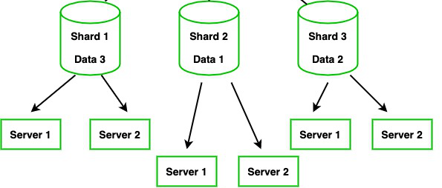
Sharding VS Replication
Sharding and replication offer independent benefits for distributed systems.
Sharding balances the write load by distributing data across different servers. Replication primarily improves read performance and improves availability.
Sharding and replication can work together effectively. For example, a system can shard data to improve performance while also replicating those shards to ensure high availability. This combination provides both scalability and reliability.

Slide 40
Massively Parallel Processing
Partitioning is effective when most queries involve reading or writing data by a single ID (e.g., in NoSQL databases) or a few IDs.
This level of support is common in many NoSQL systems, which is why they have opened up more opportunities for distributed processing.
However, In analytics use cases, you often need to read multiple columns of data from several tables, involving numerous joins and aggregations.
In such scenarios, sharding and partitioning do not provide significant benefits. This is known as Massively Parallel Processing (MPP).
This has recently led to two major developments in the big data world:
Hadoop-based data processing tools, such as MapReduce, Hadoop, and Spark,
Moder Cloud Data warehouses like Amazon Redshift, Google BigQuery, and Snowflake.
We will cover these next…

